Slide 1
Using Smartphones in Multi-Modal Qualitative Research
Dr Dimitar Karadzhov
Full resource, see: https://www.ncrm.ac.uk/resources/online/all/?id=20856

Slide 2
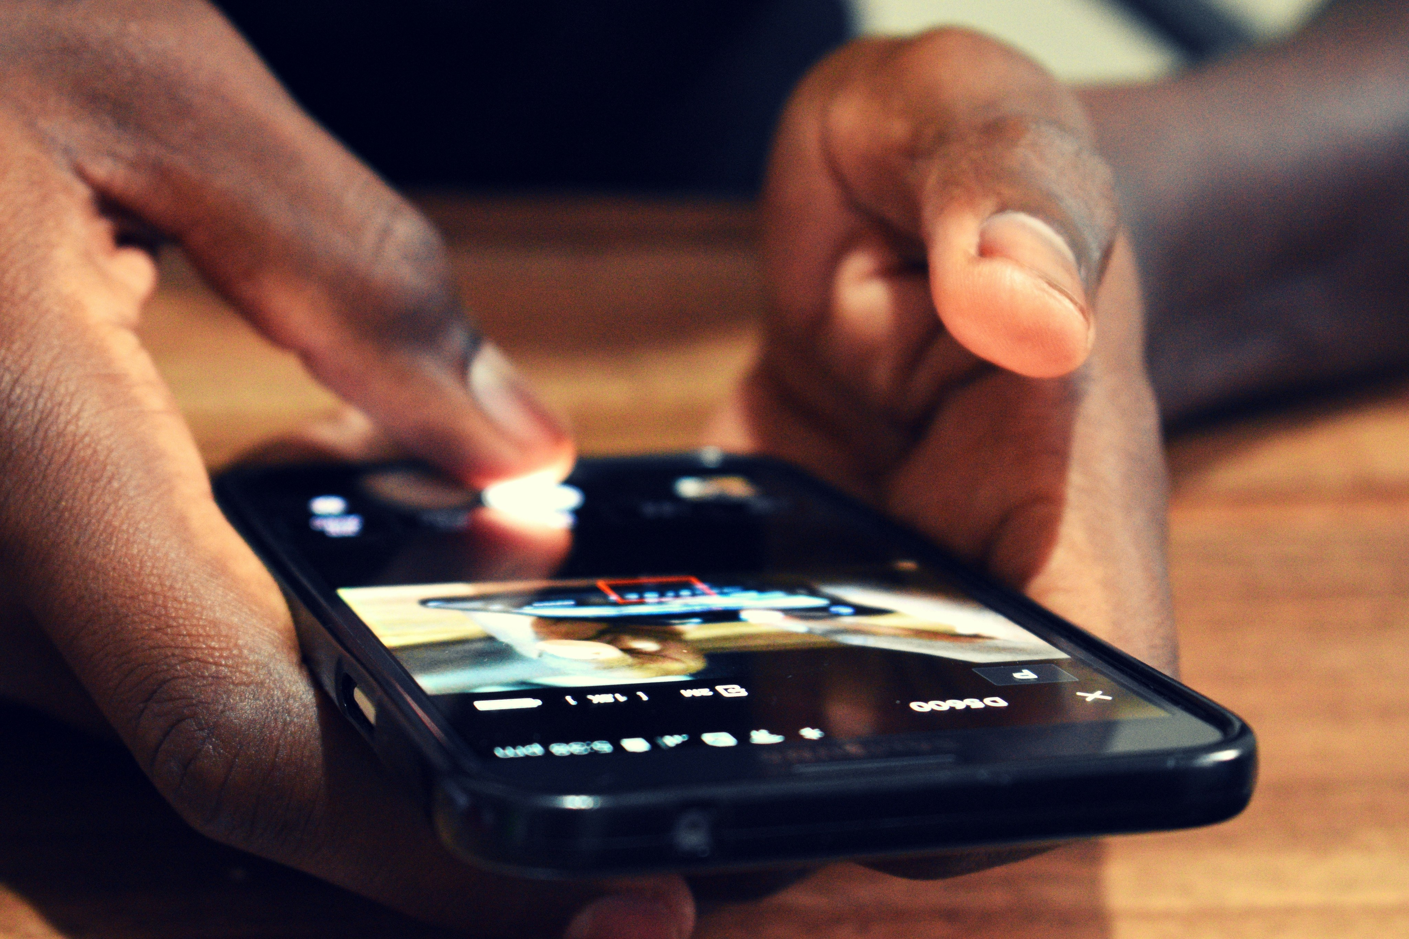
Outline
Multi-modal research: offerings, applications, design considerations
Engaging hard-to-reach populations: opportunities, risks and design adaptations
Practical strategies for ethics and funding applications involving smartphones

Slide 3
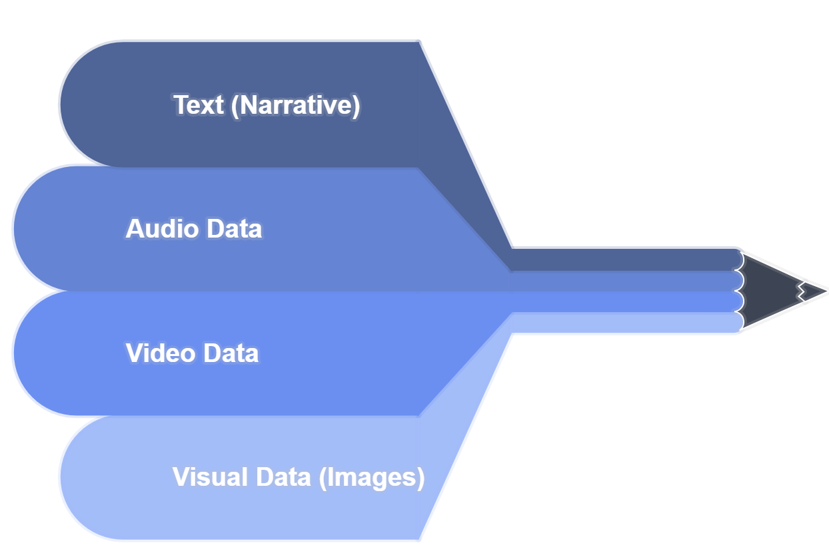
Multi-Modal Qualitative Research
Collection and integration of different data formats to gain a more comprehensive, multi-faceted understanding of a phenomenon
Triangulation and elaboration
Sequential or concurrent design
Choice of approach: degree of researcher involvement, participant demands (availability and abilities), app functionalities

Slide 4


Examples
Research Topic | Data Modalities
Asylum-seekers’ sense of community and belonging | TEXT, IMAGES, GPS
Frontline healthcare workers’ coping with stress | TEXT, VIDEO
Role of music in mental health recovery | AUDIO, ELICITATION INTERVIEWS
Homelessness and neighbourhoods | TEXT, IMAGES

Slide 5
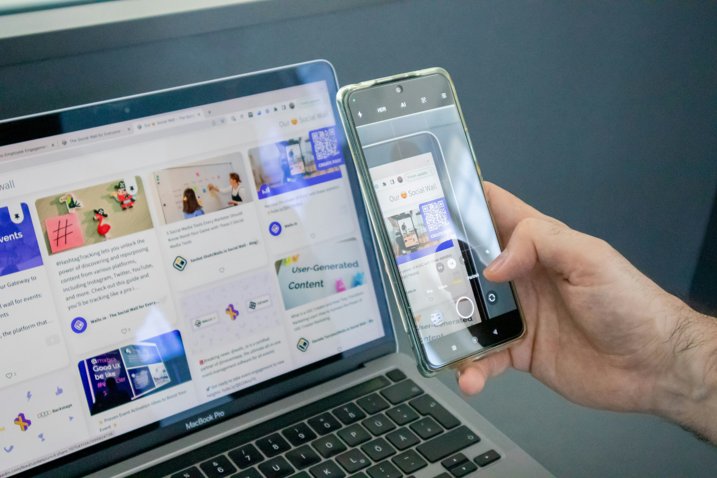
Key Considerations in Multi-Modal Research
Affordances and limitations of different data modalities
Suitability of research topic
Appropriateness of modalities for participants’ habits, preferences and contexts
Tailored ethics protocols
Analytic complexity and coherence
Epistemological congruity

Slide 6

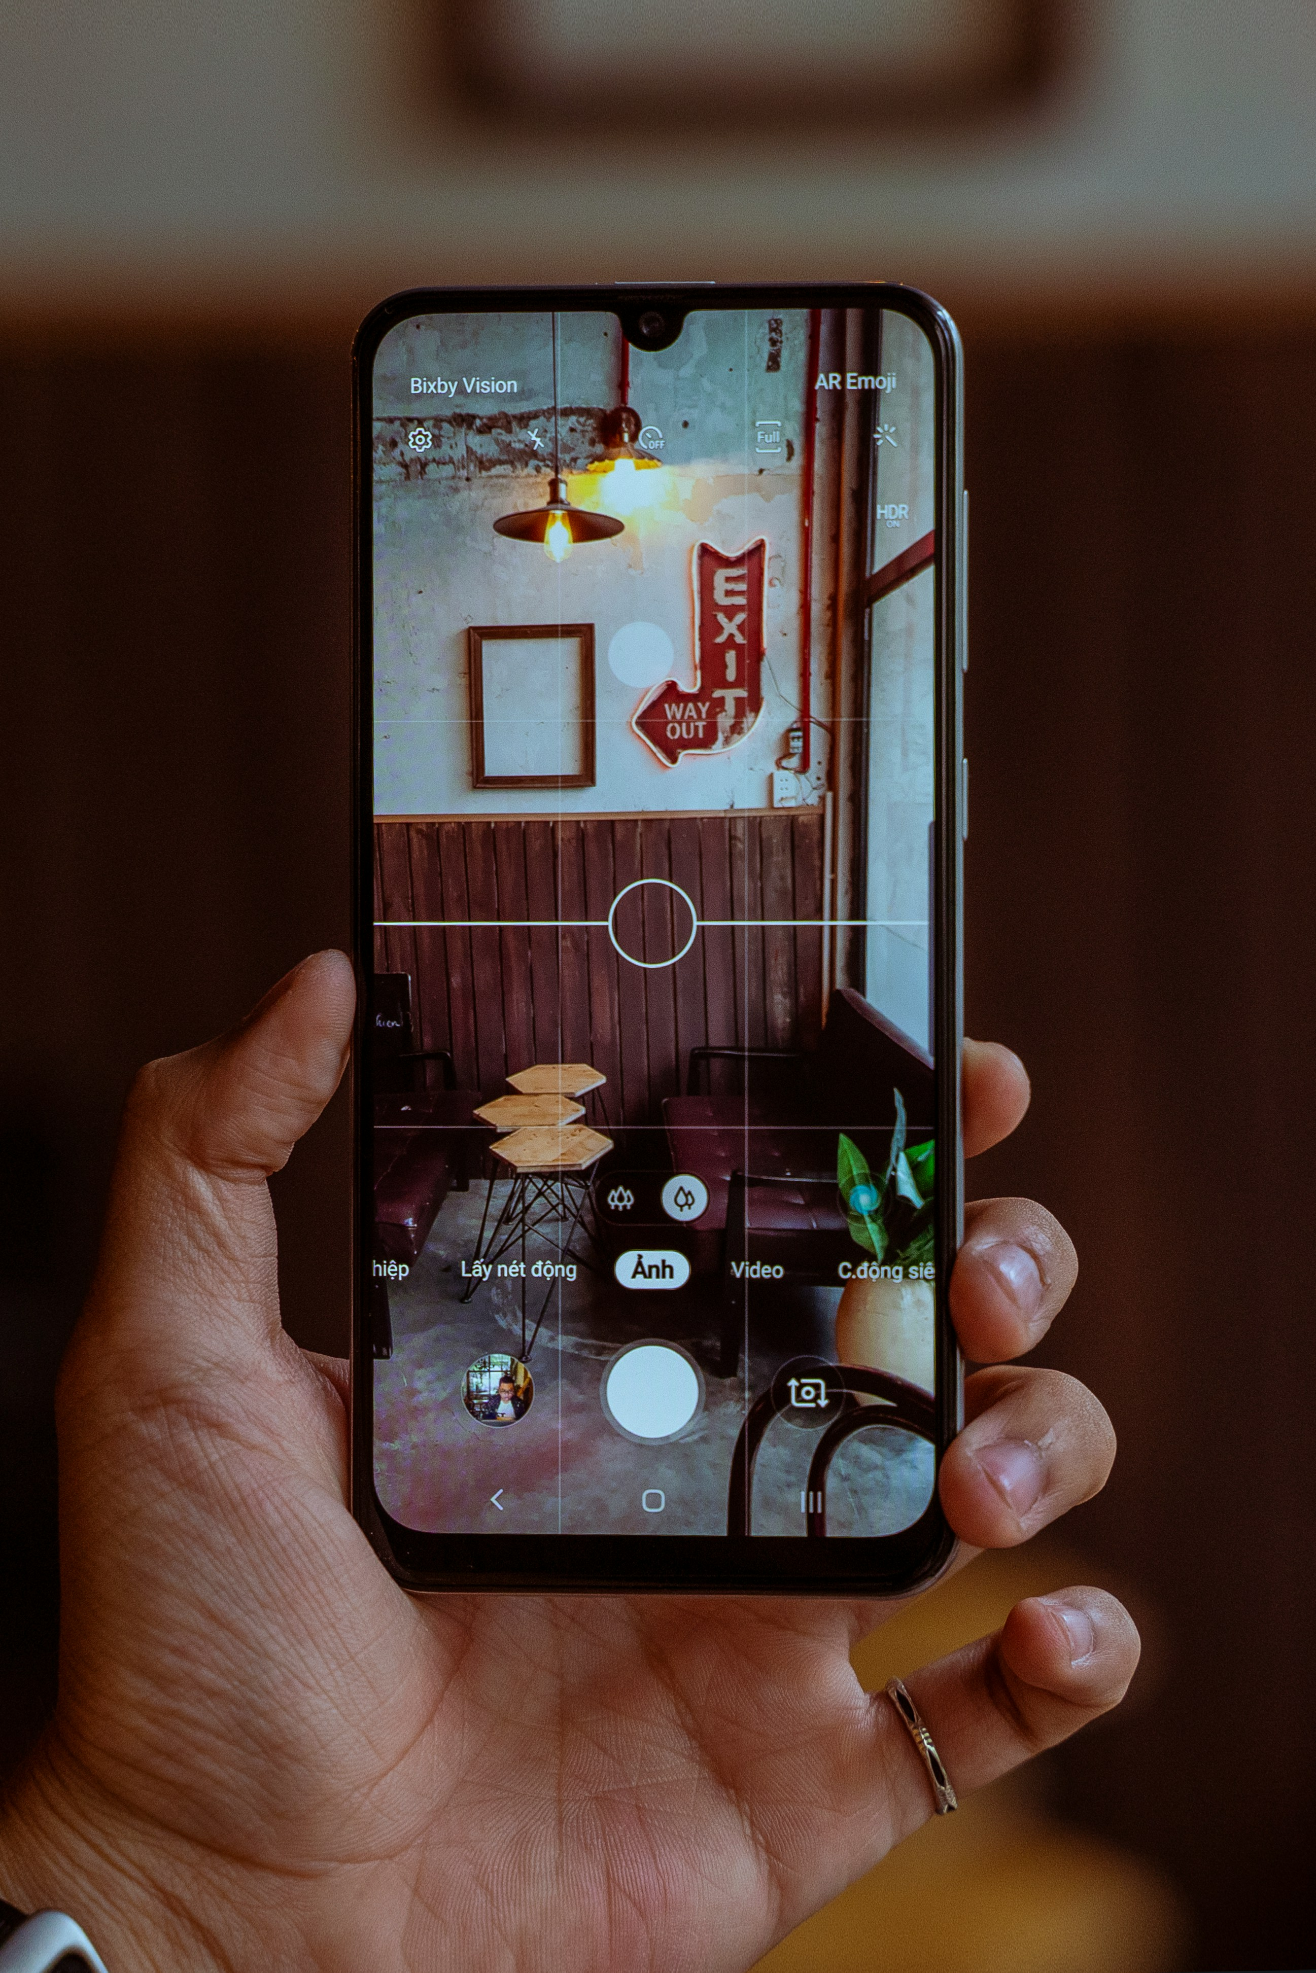
Engaging Hard-to-Reach Populations
Accessibility and flexibility
Trust and comfort
Burden
Boundaries
Safety and stigma
Karadzhov (2021): Mobile phone diaries and homelessness

Slide 7
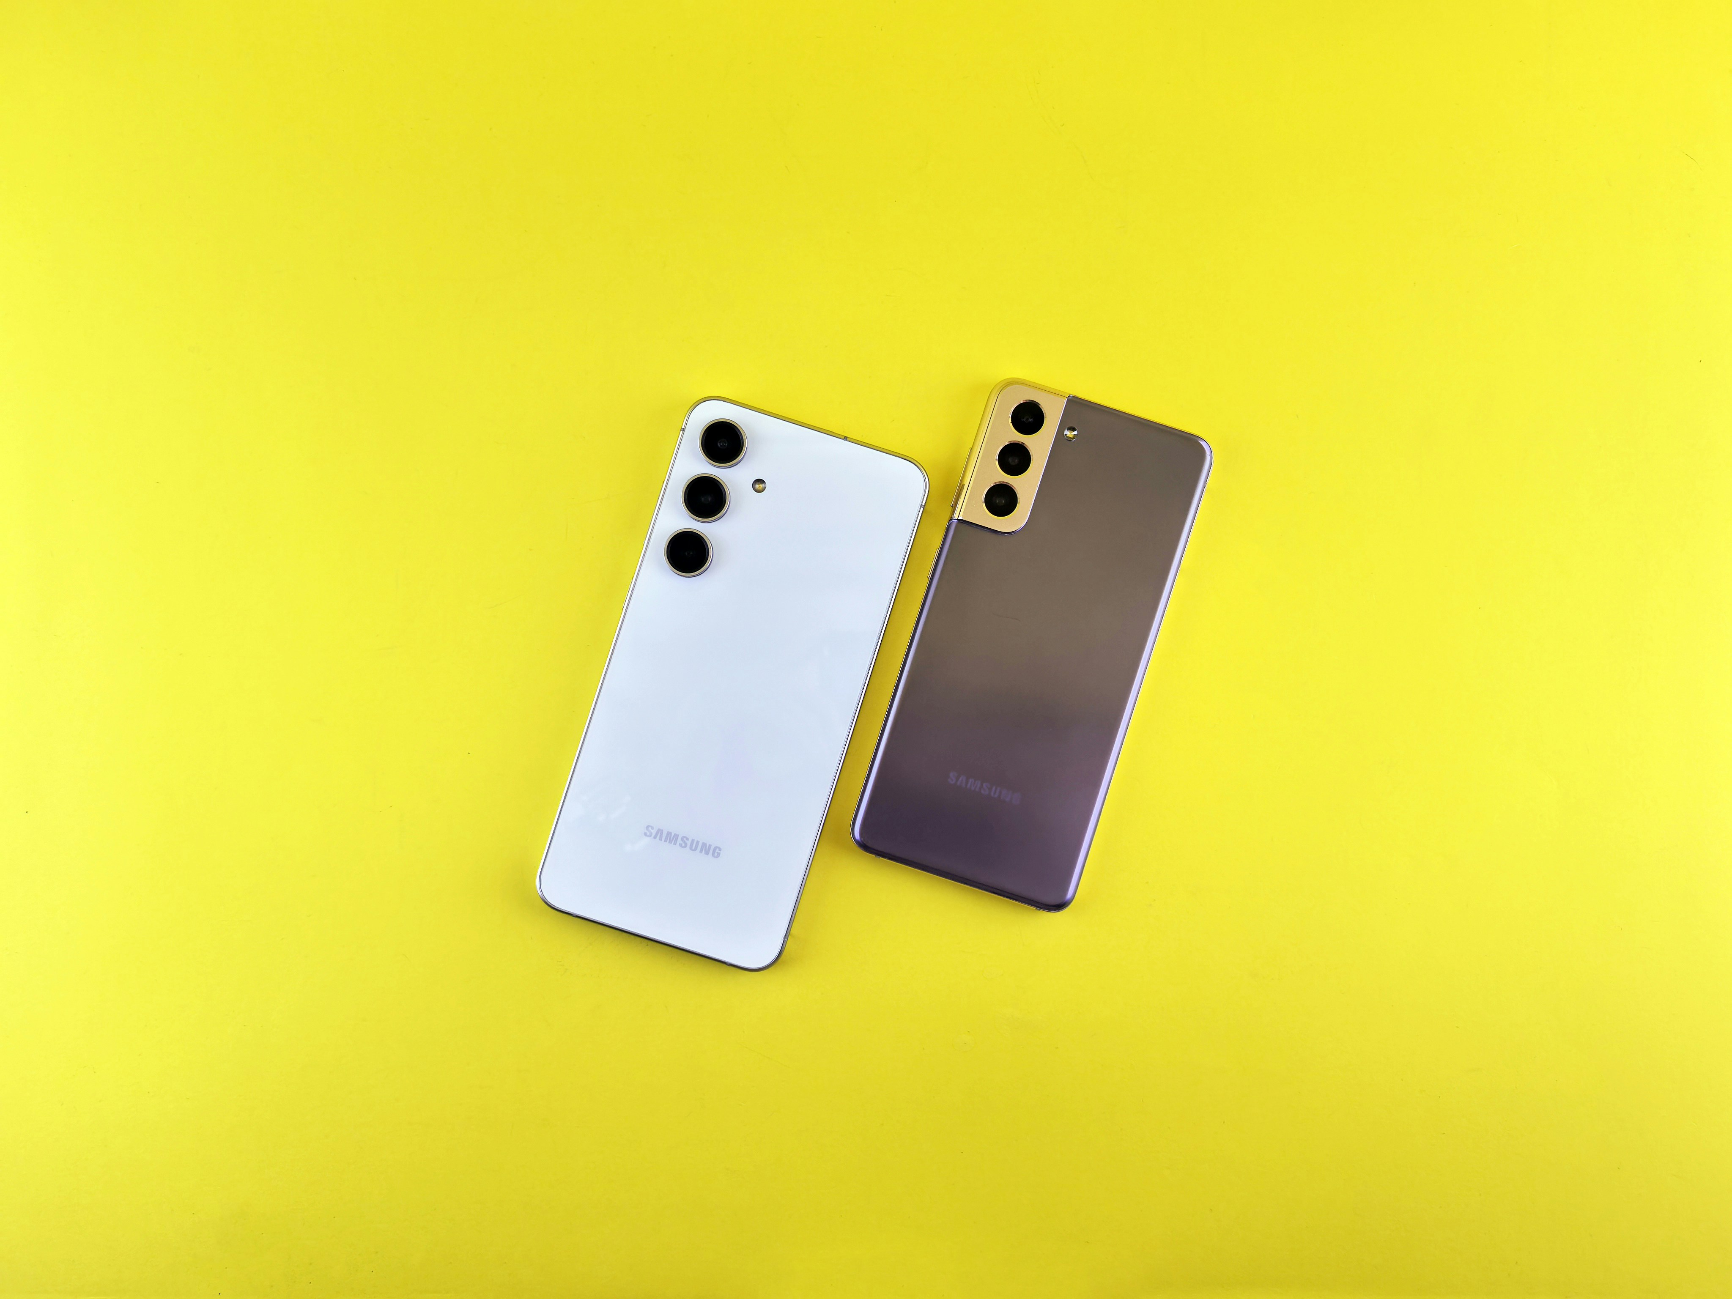
Practical Strategies for Rigorous, Ethical and Fundable Research
Feasibility and efficiency
Data privacy and management
Data collection
Permissions and participant control
Data analysis and representation

Slide 8
www.ncrm.ac.uk

